Slide 1


2nd World Conference on Communication & Computing 2024 (2nd WCONF 2024) Air Quality Analysis Using Deep Learning
Paper ID: 1600
Dr. Kanchana M
N.Suryateja
K.Abhinav reddy
Affiliation : Department of Computing technologies
SRM INSTITUTE OF SCIENCE AND TECHNOLOGY

Slide 2
Table of contents
Abstract
Literature survey
existing system with merits and demerits
Challenges
Problem statement
Objectives
Architecture/ block diagram of proposed modules
Module description
Intermediate results
Screenshots
references

Slide 3
ABSTRACT
Air pollution alludes to the issue of toxins into the air that are harmful to human well being and the entire planet. It can be described as one of the most dangerous threats that the humanity ever faced.
It causes damage to animals, crops, forests etc. To prevent this problem in transport sectors have to predict air quality from pollutants using machine learning techniques. Subsequently, air quality assessment and prediction has turned into a significant research zone.

Slide 4
Literature survey
Sl.no | Year | Name of paper | Author’s | Paper title | Methodology used | Dataset used | Advantages | disadvantages | Furter scope
1 | 2022 | conference | B D Parameshachari; G M Siddesh; V. Sridhar; | Prediction and Analysis of Air Quality Index using Machine Learning Algorithms | Decision Tree Regression (DTR), Linear Regression (LR), Random Forest Regression (RFR) and Support Vector Regression (SVR) | Air Quality Index (AQI) | approaches with a maximum accuracy low | We predicting accuracy high | relative investigation for better performance and accuracy.

Slide 5
Literature survey
Sl.no | Year | Name of paper | Author’s | Paper title | Methodology used | Dataset used | Advantages | disadvantages | Furter scope
2 | 2021 | Innovation | K. M. O. V. K. Kekulan; B. T. G. S Kumara; | Comparative Analysis of Machine Learning Algorithms for Predicting Air Quality Index | Decision Tree, Support Vector Machine (SVM), and Random Forest | air quality analysis and forecasting | It outperformed the other approaches with a maximum accuracy of 74% | Maximun accuracy above 90% | These results will assist to enhance present research, and guide the future

Slide 6
Literature survey
Sl.no | Year | Name of paper | Author’s | Paper title | Methodology used | Dataset used | Advantages | disadvantages | Furter scope
3 | 2023 | journal | M Sitha Ram; Chintamreddy Reshmasri; Shai Shahila; Juluru Venkata Pavan Saketh | Air Quality Prediction using Machine Learning Algorithm | XGboost algorithm | Air pollution | predict the air quality with high accuracy rate. | Predict the air quality with Above 90% accuracy | This study proposes XGboost algorithm to forecast the air quality

Slide 7
Literature survey
Sl.no | Year | Name of paper | Author’s | Paper title | Methodology used | Dataset used | Advantages | disadvantages | Furter scope
4 | 2021 | conference | Tanisha Madan; Shrddha Sagar; Deepali Virmani | Air Quality Prediction using Machine Learning Algorithms –A Review | Linear Regression, Decision Tree, Random Forest, Artificial Neural Network, Support Vector Machine | air pollution are Carbon dioxide, Nitrogen dioxide, carbon monoxide | Various research is being done in this field but still results are still not accurate | results are accurate | Machine learning algorithms helps in determining the air quality index

Slide 8
Literature survey
Sl.no | Year | Name of paper | Author’s | Paper title | Methodology used | Dataset used | Advantages | disadvantages | Furter scope
5 | 2023 | Journal | Chunhao Liu; Guangyuan Pan; Dongming Song; Hao Wei | Air Quality Index Forecasting via Genetic Algorithm-Based Improved Extreme Learning Machine | SVM (Support Vector Machines) and DBN-BP (Deep Belief Networks with Back-Propagation) | Air Quality Index (AQI) | It outperformed the other approaches with a maximum accuracy of 74% | Predict the air quality with Above 90% accuracy | he results show that the proposed model trains faster and makes more accurate predictio

Slide 9
Literature survey
Sl.no | Year | Name of paper | Author’s | Paper title | Methodology used | Dataset used | Advantages | disadvantages | Furter scope
6 | 2021 | Journal | Zeynep Bilen; Ferhat Bozkurt | Comparison of Different Machine and Deep Learning Techniques to Predict Air Quality Index: A Case of Kocaeli Province | k-Nearest Neighbor, Naive Bayes, Logistic Regression, Decision Trees, Random Forest, Support Vector Machines (SVM), lstm | Air pollution | the highest accuracy value | the lowest accuracy value | highest AUC value was reported as 98% with the LSTM model.

Slide 10
Literature survey
Sl.no | Year | Name of paper | Author’s | Paper title | Methodology used | Dataset used | Advantages | disadvantages | Furter scope
7 | 2023 | Journal | Mohammad Mehrabi; Marco Scaioni; | Forecasting Air Quality in Kiev During 2022 Military Conflict Using Sentinel 5P and Optimized Machine Learning | multilayer perceptron neural network, electromagnetic field optimization (EFO) algorithm | Air pollution | the highest accuracy value | Four scenarios are defined by considering the reduced/original dataset | its prediction accuracy can be improved.

Slide 11
Literature survey
Sl.no | Year | Name of paper | Author’s | Paper title | Methodology used | Dataset used | Advantages | disadvantages | Furter scope
8 | 2020 | Journal | Dan Zhang; Simon S. Woo | Real Time Localized Air Quality Monitoring and Prediction Through Mobile and Fixed IoT Sensing Network | Internet of Things (IoT) | Air pollution | the highest accuracy value | It take more time to execute | Effective air quality monitoring and prediction for a smart city application

Slide 12
Literature survey
Sl.no | Year | Name of paper | Author’s | Paper title | Methodology used | Dataset used | Advantages | disadvantages | Furter scope
9 | 2021 | Journal | Ichrak Mokhtari; Walid Bechkit;Hervé Rivano; | Uncertainty-Aware Deep Learning Architectures for Highly Dynamic Air Quality Prediction | long short term memory (LSTM) and convolutional neural network (CNN) | Air pollution | the highest accuracy value | their performances were further excavated | the results of the uncertainty techniques and we derive insights

Slide 13
Literature survey
Sl.no | Year | Name of paper | Author’s | Paper title | Methodology used | Dataset used | Advantages | disadvantages | Furter scope
10 | 2016 | Journal | Khaled Bashir Shaban; Abdullah Kadri; Eman Rezk | Urban Air Pollution Monitoring System With Forecasting Models | support vector machines, M5P model trees, and artificial neural networks (ANN) | Air pollution | the highest accuracy value | It take more time to execute | useful for alarming applications in areas with high air pollution levels

Slide 14
Literature survey
Sl.no | Year | Name of paper | Author’s | Paper title | Methodology used | Dataset used | Advantages | disadvantages | Furter scope
11 | 2020 | Journal | Snehanjan Acharyya; Sudip Nag; Prasanta Kumar Guha] | Selective Detection of VOCs With WO₃ Nanoplates-Based Single Chemiresistive Sensor Device Using Machine Learning Algorithms | the sensor device were engaged with machine learning algorithms | Air pollution | the highest accuracy value | adequate sensor response was observed for each target VOC | predicted in a quantitative manner using a regression model with fair accuracy.

Slide 15
Literature survey
Sl.no | Year | Name of paper | Author’s | Paper title | Methodology used | Dataset used | Advantages | disadvantages | Furter scope
12 | 2022 | Journal | Jingyang Wang; Lukai Jin; Xiaolei Li; Siyuan He; | A Hybrid Air Quality Index Prediction Model Based on CNN and Attention Gate Unit | Convolutional Neural Network (CNN) and Attention Gate Unit (AGU) | Air pollution | the highest accuracy value | their performances were further excavated | Other models by comparing with the other nine models on the same data set.

Slide 16

existing system with merits and demerits
Merits:
Accuracy and Predictive Power: Machine learning models can provide accurate predictions of air quality based on historical and real-time data. They can capture complex patterns and relationships in the data that may be difficult for traditional models to discern.
Real-time Monitoring: Machine learning models can process real-time sensor data to provide up-to-the-minute information about air quality. This is crucial for making timely decisions to protect public health, such as issuing pollution alerts or recommending precautionary measures.
Demerits:
Data Quality: The effectiveness of machine learning models depends on the quality and completeness of the input data. Inaccurate or missing data can lead to unreliable predictions.
Data Volume: Training machine learning models for air quality analysis requires a substantial amount of historical data. In some regions or for specific pollutants, data may be limited, making it challenging to build accurate models.

Slide 17
Challenges
Air quality analysis using machine learning presents several challenges that must be addressed to develop effective and reliable systems. These challenges encompass data, modeling, deployment, and ethical considerations. Here are some key challenges:
Data Quality and Availability:
Limited Historical Data: Obtaining a sufficiently large and high-quality dataset for training machine learning models can be challenging, especially for regions or pollutants with limited monitoring history.
Data Imbalance: Imbalanced datasets, where one class (e.g., clean air) significantly outweighs another (e.g., polluted air), can lead to biased models and inaccurate predictions.
Model Complexity and Interpretability:
Complex Models: Deep learning and other complex models may provide high accuracy but lack interpretability, making it challenging to understand and trust their predictions.
Interpretability: Ensuring that models provide understandable explanations for their predictions is crucial for gaining the trust of stakeholders and decision-makers.

Slide 18
Problem statement
Urban air pollutant attention forecast is coping with a surge of large ecological monitoring data and intricate alterations in air pollution. This necessitates effective estimating methods to strengthen prediction accuracy and avoid grave contamination episodes, thereby improving ecological administration resolution-making capacity.
A brand new contaminant concentration estimation process is established on sizeable amounts of ecological knowledge and deep learning approaches. This integrates colossal data using two forms of deep networks.

Slide 19
Objectives
The objectives of air quality analysis using machine learning are to leverage data-driven approaches to better understand, monitor, predict, and improve air quality. These objectives align with various stakeholders, including government agencies, environmental organizations, researchers, and the general public, and they contribute to addressing air pollution-related challenges. Here are the key objectives:
Monitoring and Assessment:
Real-time Monitoring: Continuously monitor air quality by collecting and analyzing data from various sensors and sources, including monitoring stations, satellite imagery, and IoT devices.
Prediction and Early Warning:
Predictive Modeling: Develop machine learning models that can forecast changes in air quality based on historical and real-time data. These models can provide early warnings of pollution spikes or deteriorating air quality.
Identification of Pollution Sources:
Source Attribution: Use machine learning to identify and attribute pollution sources, such as industrial emissions, vehicular traffic, wildfires, or natural events. This information can aid in pollution control and regulation.

Slide 20
ARCHITECTURE
Data Cleaning
Air quality prediction based on dataset(So2,No2)
Data Preprocessing(fillna().isnull())
Data Selection
Data Storage
Data Transformation
Deep Learning Model Development
Training
(80%)
Testing
(20%)
Deep learning
Result

Slide 21
Modules
Data Collection and Pre-processing
Data cleaning
Data transformation
Data selection
Data input
Result

Slide 22
Modules Description: Data Collection and Pre-processing
Data Collection is one of the most important tasks in building a machine learning model.
It is the gathering of task related information based on some targeted variables to analyse and produce some valuable outcome.
However, some of the data may be noisy, i.e. may contain inaccurate values, incomplete values or incorrect values.
Hence, it is must to process the data before analysing it and coming to the results.
Data pre-processing can be done by data cleaning, data transformation, data selection.

Slide 23
Data Collection and Pre-processing
Data cleaning: Fill in missing values, smooth noisy data, identify or remove outliers, and resolve inconsistencies.
Data transformation may include smoothing, aggregation, generalization, transformation which improves the quality of the data.
Data selection includes some methods or functions which allow us to select the useful data for our system.

Slide 24
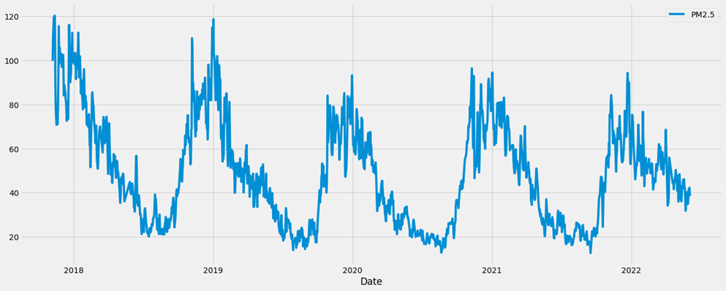
Data input:
After finding the best algorithm we are used that algorithm for finding the spam website.
LSTM
Intermediate results :

Slide 25
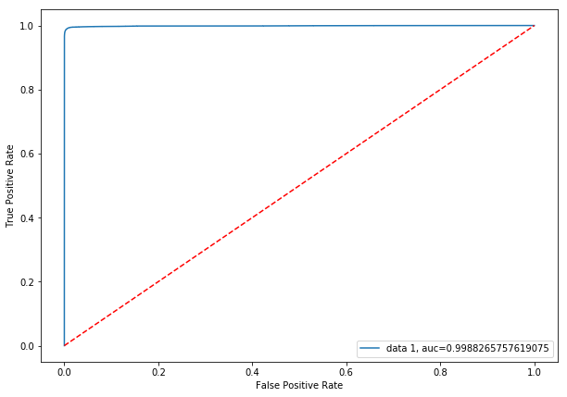
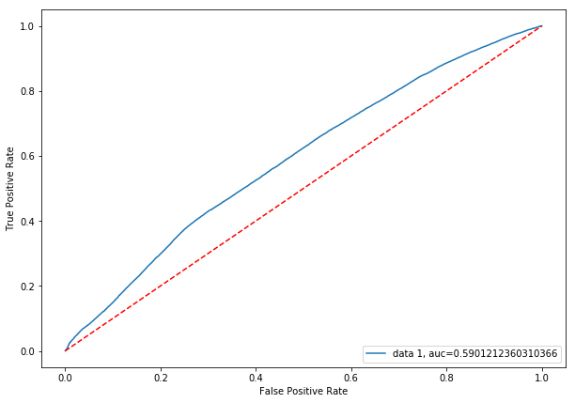
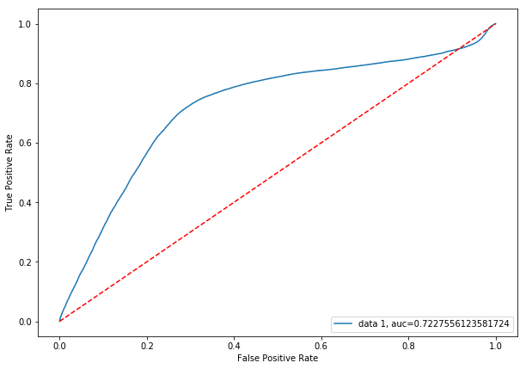
Precision and Recall Graphs

Slide 26
RESULT
Based on that dataset we can get the result used our lstm to predict the result.
Here we can also find out the accuracy rate of the prediction.
It will be helpful for finding spam website.

Slide 27
Reference
[1] (2016). PhishMe Q1 2016 Malware Review. [Online]. Available: https://phishme.com/project/phishme-q1-2016-malware-review/
[2] A. Belabed, E. Aimeur, and A. Chikh, ‘‘A personalized whitelist approach for phishing webpage detection,’’ in Proc. 7th Int. Conf. Availability, Rel. Security (ARES), Aug. 2012, pp. 249–254.
[3] Y. Cao, W. Han, and Y. Le, ‘‘Anti-phishing based on automated individual white-list,’’ in Proc. 4th ACM Workshop Digit. Identity Manage., 2008, pp. 51–60.
[4] T.-C. Chen, S. Dick, and J. Miller, ‘‘Detecting visually similar Web pages: Application to phishing detection,’’ ACM Trans. Internet Technol., vol. 10, no. 2, pp. 1–38, May 2010.
[5] N. Chou, R. Ledesma, Y. Teraguchi, D. Boneh, and J. C. Mitchell, ‘‘Clientside defense against Web-based identity theft,’’ in Proc. 11th Annu. Netw. Distrib. Syst. Security Symp. (NDSS), 2004, pp. 1–16
[6] C. Inc. (Aug. 2016). Couldmark Toolbar. [Online]. Available: http://www.cloudmark.com/desktop/ie-toolbar
[7] J. Corbetta, L. Invernizzi, C. Kruegel, and G. Vigna, ‘‘Eyes of a human, eyes of a program: Leveraging different views of the Web for analysis and detection,’’ in Proceedings of Research in Attacks, Intrusions and Defenses (RAID). Gothenburg, Sweden: Springer, 2014.
[8] X. Deng, G. Huang, and A. Y. Fu, ‘‘An antiphishing strategy based on visual similarity assessment,’’ Internet Comput., vol. 10, no. 2, pp. 58–65, 2006.
[9] Z. Dong, K. Kane, and L. J. Camp, ‘‘Phishing in smooth waters: The state of banking certificates in the US,’’ in Proc. Res. Conf. Commun., Inf. Internet Policy (TPRC), 2014, p. 16.

